Slide 1
Predicting Food Insecurity at the County Level in New York State
Author: Jonathan Burns
Email: Jonathan.burns54@spsmail.cuny.edu
May 17, 2025

Slide 2
Overview of Presentation(Agenda)
Problem and Motivation for the research
Literature review
Research goals & hypothesis
Methods & Data
Data preparation discussion
Methods discussion
Model Construction
Model Performance
Key Findings & Results
Conclusions, Implications & Future Work

Slide 3
Problem & Motivation
According to the 2024 UN Report: Hunger numbers stubbornly high for three consecutive years as global crises deepen, there were approximately 2.33 billion people who faced moderate to severe food insecurity within 2023.
Similarly, the New York State Department of Health reported that an estimated 1 in 4 adults experienced food insecurity in New York during 2023.
Despite the advantages that New York holds economically, average New Yorkers are struggling to put food on the table.
Notes:
Key challenges like high cost of living, income inequality and uneven resource distribution are exacerbated in and around New York city, more than they are throughout the rest of the state. So this was something to watch for in the analysis.

Slide 4
Research Goal & Hypothesis
The primary goal of this research project is to predict yearly food insecurity across New York State Counties using data from 2020-2024.
The second goal is to identify high, medium and low risk counties based on predictions and growth from previous years.
Lastly is some form of geographical representation of the predictions on the county level
The hypothesis for this project posits that food insecurity at the county level in New York State can be successfully predicted using a combination of economic, demographic, social, health and geographic predictors, modeled through either XGBoost or LSTM.
Secondly, incorporating longitudinal data will improve the predictive accuracy of the model by capturing temporal trends and year-over-year changes in food insecurity.

Slide 5
Methods & Data – Data Preparation
Data Source: County Health Rankings & Roadmaps (2020–2024)
This is a project created by the University of Wisconsin’s Population Health Institute- School of Medicine and Public Health.
While five years was the initial target date range for this project, the 2025 data was later found to only be an estimate (which makes sense because they only have a few months if that).
All data is pulled apart by an R program after the yearly excel files are downloaded and only the variables of interest are selected and loaded up into a datamart to be used by both R and Python programs for the XGBoost and LSTM models.
As mentioned previously, the dependent variable is percent food insecure and is used as the main predicted variable in the models.
The percent food insecure variable comes from the Map The Gap program, which is a subsidiary program of the larger network of food banks and meal programs called Feeding America.
The predictors variables come from a range of different places and cover a wide array of fields.
Some of the more notable ones are childhood poverty, median income and school lunch enrollment.
Notes:
* Note that the code to pull 2025 data is still left in the program so when this is run again the 2025 full year can get pulled in and added to the models.

Slide 6
Methods & Data – Model Construction
As it was mentioned above, the primary goal of the research was to set up two separate branches of machine learning to do the same thing.
XGBoost and Long Short-Term Memory (LSTM) were the two machine learning models used for this research paper.
After creating baseline models for each algorithm, several experiments were set up to test these algorithms across a range of feature engineering, hyperparameter tuning and data pre-processing.
These performance and accuracy changes were logged and organized inside of a table seen in the next slide.
Notes:
After creating a baseline model for each algorithm (XGBoost in R and LSTM in Python)

Slide 7
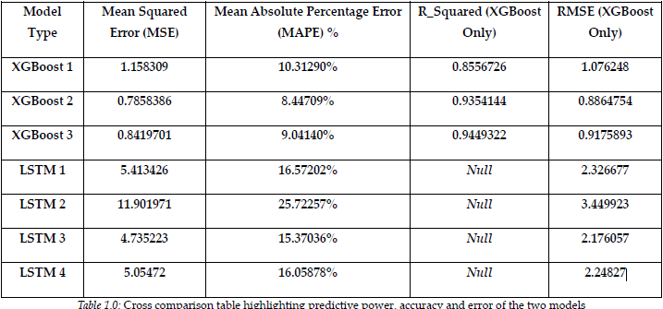
Methods & Data – Model Performance
Notes:
XGBoost models demonstrated superior predictive power, accuracy, and consistency; Model 1 (a baseline XGBoost model, with minimal feature engineering and preprocessing) outperformed even the best performing LSTM model by a wide margin. With an R-Squared of 85% a MAPE of 10.3%, MSE of 1.15 and RMSE of 1.07, XGBoost model 1 was anywhere from .5 to 4x more performant than any LSTM. XGBoost models 2 and 3 showed notable improvements in performance over the first model (and any LSTM consequently).
Growing R-squared metrics across the two models and a concurrent drop in MSE, MAPE% and RMSE can be attributed to a few changes. XGBoost model 2 brings two specific changes from model 1. This model is tuned to be faster, using a tuning grid and parallel processing. In addition to the grid and the parallel processing mechanics, model 2 also features a sped up cross-validation section, reducing the stock amount of folds from model 1, from 10 to 5 folds, in turn producing a faster, more perf
ormant model.
The improvements in the LSTM models did in fact make a difference in lowering MAPE, MSE and RMSE, however, not enough to move through with any real evaluation against of on the better performing XGBoost models.

Slide 8
Key Findings
The top three predictors in XGBoost Experiment 3 were childhood poverty, median income, and free/reduced lunch enrollment drove most variance in food insecurity.
Surprisingly the 1-year temporal lag feature was much more predictive than the 2-year. Indicating that recent shocks might matter more than longer term trends present in counties.
Demographic predictors had much less of an impact than other studies in the literature. More research into this area is needed

Slide 9
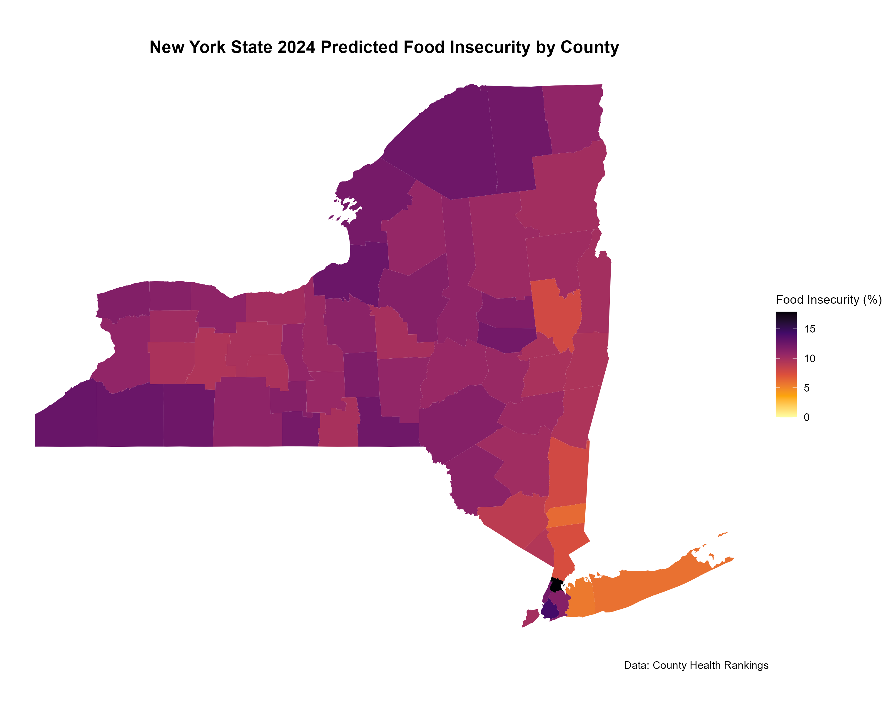
Policy Implications
Notes:
Top Predictors: Childhood poverty, median income, school lunch enrollment and account for a majority of the variance in the
Temporal Insight: 1-year lag mattered more than 2-year (short-term trends dominate).
Heightened food insecurity does not discriminate geographically:
Targeted Aid: Focus resources on high-risk counties.
Program Impact: COVID-era policies (SNAP, child tax credits) reduced food insecurity—advocate for similar measures.

Slide 10
Policy Implications – Cont.

Slide 11
Limitations
Overly poor performance of the LSTM model indicates that there simply is not enough data for the algorithm to successfully capture temporal patterns well enough for LSTM to thrive.
Thus, the first step to further this research would be to use the County Health Rankings full suite of yearly data (dating back to 2010).
In addition to the lack of data for LSTM, there may be better ways of capturing the geographical nuances of each county and how they effect that counties relationship with food insecurity.
Possible ways of doing this could be new variables calculating average travel times to a grocery store within that county or access to a car, etc.
A final direction for future work would be to make a much larger system that acts as a dashboard for community programs, food banks and policy leaders to look at their individual regions predicted food insecurity.
Notes:
If I could go back in time I would pull in as much data as time permitted, but this step of the process admittedly took a long time. so expanding back another 10 years was daunting.
I visualize this as a website that’s attached to an Rshiny application or a python equivalent built off of a further fine-tuned XGBoost prediction model that gets live updated when new data is released by County health rankings.

Slide 12
Full Paper:
https://github.com/jonburns2454/DATA_698

